Slide 1
Growing Economic Problems of Pakistan: and
“Umeed” a project to kick-start sustainable growth and employment generation
at the
GC University Faisalabad
May 30, 2012
Sohail Jehangir Malik Phd
Chairman
Innovative Development Strategies (Pvt.) Ltd, Pakistan
Senior Research Fellow
International Food Policy Research Institute, USA

Slide 2


Slide 3
Layout of this Presentation
Some Stark Realities
Economic Performance - Alarming Trends
Official Explanations that defy economic logic
Deliberately Eroded Statistical Basis
Existing Development Strategy in Pakistan?
  Non existent - ill conceived - not implementable
The Need for new thinking
  Connecting the Disconnects
  Taking matters into our own hands
The Crucial Role of the Educated Young Entrepreneurs of Pakistan

Slide 4
The People of Pakistan today face every conceivable risk that is possible
RISKS | Micro (idiocyncratic) | Meso | Macro (Covariate)
Natural |  | Rainfall Landslide Volcanic eruption | Earthquakes Floods Drought Strong winds
Health | Illness Injury Disability | Epidemic
Life-cycle | Birth Old age Death
Social | Crime Domestic violence | Terrorism Gangs | Civil strife War Social upheaval Output collapse
Economic | Unemployment Harvest failure Business failure | Resettlement | Balance of payment Financial crisis Technology/trade induced terms of trade shocks
Political | Ethnic discrimination | Riots | Political default on social programs Lip Service to Reform
Environmental |  | Pollution Deforestation Nuclear disaster

Slide 5
Sectoral Real Growth Rates
Source: Pakistan Economic Survey 2010-11

Slide 6
Imports, Exports and Trade Balance
Source: Pakistan Economic Survey 2010-11

Slide 7
Investment and Savings as % of GDP
Source: Pakistan Economic Survey 2010-11

Slide 8
Revenue, Expenditure and Deficit as % of GDP
Source: Pakistan Economic Survey 2010-11

Slide 9
Current and Development Expenditures
Source: Pakistan Economic Survey 2010-11

Slide 10
Expenditure on Education and Health as % of GDP
Source: Pakistan Economic Survey 2010-11

Slide 11
Money Supply (M2)
Source: Pakistan Economic Survey 2010-11

Slide 12
M*V = P*Q
The Fundamental Identity

Slide 13
Trends in Monthly CPI
(July 2008 to April 2012)
Source: Pakistan Bureau of Statistics (various issues)

Slide 14
Exchange Rate (Rs/US$)
Source: Pakistan Economic Survey 2010-11

Slide 15
Real and Nominal Wages of Skilled and Unskilled Workers
Source: Pakistan Economic Survey 2010-11

Slide 16
Terms of Trade
It takes about 60 kilograms of wheat flour to meet minimum requirements of a family of 6 for one month!
 | Kgs. of Wheat flour per one day of wage labour in 2011
Lahore | 13
Karachi | 12
Peshawar | 10
Quetta | 11

Slide 17
How Official Numbers
Deliberately Hide the Reality:
Two Examples

Slide 18
Example 1: The Increase in Employed between 2005-2008 – simply a definitional adjustment
Source: Labour Force Surveys

Slide 19
Example 2: Poverty in Pakistan

Slide 20
Despite a decline in poverty, real household consumption expenditure remained stagnant
Source: HIES (various issues)
For real expenditure (2000-01=100)

Slide 21
Share of food expenditure in household consumption expenditure shows a sharp increase after 2005-06
Source: HIES (various issues)

Slide 22
Example 2: Poverty Estimates – Provincial Dimensions – Poverty in Sindh was made to decline by 15% between 2001 and 2004 to show 5% overall decline!!
Source: World Bank (2007)

Slide 23
Non-income measures of poverty:
Stagnant Gross Enrolment Rate at Primary Level
Source: HIES (various issues)

Slide 24
Declining proportion of households having access to piped water
Source: HIES (various issues)

Slide 25
Rising proportion of housing units with one room since 2008-09
Source: HIES (various issues)

Slide 26
Declining Perception about household’s economic situation as compared to previous year
Source: HIES (various issues)

Slide 27
One Binding Constraint amongst many
Installed Capacity of Electricity (000 MW)
Source: Pakistan Economic Survey 2010-11

Slide 28
Slump in the Sources of Transport & Communications
Source: Pakistan Economic Survey 2010-11

Slide 29
Existing Development Strategy in Pakistan:
New Growth Framework ?
Markets, Cities, Youth and Connectivity
No implementation
Continuing Reliance on:
Macro-economic Stability – Policy Choices?
  or need to meet fiscal imperatives
Gains from Globalization?
  or risk of snuffing out any possible growth
Demographic Divident?
  or demographic death trap

Slide 30
Missing Links
Weak Data and Weaker Analyses
Absence of M&E and effective policy research and extension
  Scant Regard for what works and what doesn’t and how it can be replicated and up-scaled
Little understanding or consideration of the complex micro-macro linkages and sectoral inter-relationships
No consideration of the importance of institutions

Slide 31
New Thinking Requires……….
Focus on the neglected rural sector
BUILD THE MISSING LINKAGES
Evidence from Pakistan
  The Rural Investment Climate survey 2005
  The Surveys of Domestic Commerce 2006
The need for focus on institutions
The need to involve the abundant factor

Slide 32
Rural – The neglected sector in Pakistan’ s Development Strategy
68% of the population is rural
High incidence of rural poverty (39%?!)
High agricultural growth appears to have coincided with rising poverty levels
Recognition that non-farm sector growth is necessary to address rural poverty.
Share of household income from rural non-farm activities is growing

Slide 33
What Makes “Rural” Areas Special?
There are sharp differences in economic and social constraints and outcomes between rural and urban areas
  Poverty rates in rural areas are generally higher than in urban areas [although LGO2001 has obliterated the definitional distinction]
Public service delivery and outcomes are generally much poorer in rural areas
  Infant mortality rates higher
  Birth rates higher
  Poorer access to health services
  Poorer quality educational infrastructure, services and outcomes
Major role of agriculture in the rural economy BUT
  Seasonal labor demand
  Large fluctuations in agricultural output, price and incomes related to weather and pest

Slide 34
Share of Major Sectors in GDP and Employment (2007-08)
Source: Pakistan Economic Survey 2007-08

Slide 35
Relying on Government is NOT the answer

Slide 36
Rethinking Development Strategy
THE FUNDAMENTAL QUESTION
The structural transformation of Pakistan’s economy has not been accompanied by a concomitant decline in the proportion of labour employed in agriculture – WHY?

Slide 37
Distribution of Pakistan’s Poor Households 2007-08:
42% are in the Rural Non Farm Sector
Source: HIES 2007-08

Slide 38
The growth linkages of the rural non-farm economy run in both directions
Production linkages (forward and backward)
Consumption linkages
Labor market linkages
Investment linkages
Spatial linkages

Slide 39
Distribution of Enterprises by Type for Rural and Small Towns in Punjab (2005)
Source: Rural Investment Climate Survey (2005)

Slide 40
Profile of Rural Enterprises in Pakistan (2005)
 | Rural | Small Town | Total
Average No. of Workers | 1.97 | 2.05 | 2.01
No. of Family Workers | 1.29 | 1.37 | 1.33
No. of Hired Workers | 0.68 | 0.68 | 0.68
Average age (years) | 9.17 | 9.03 | 9.10
Stand-alone businesses (%) | 94% | 67% | 80%
Share of firms registered (%) | 28% | 20% | 24%
Sole proprietorships (%) | 95% | 94% | 94%
Source: Rural Investment Climate Survey (2005)

Slide 41
Forward Linkages of Rural Non Farm Enterprises
(share of sales by location)
Source: Rural Investment Climate Survey (2005)

Slide 42
Backward Linkages of Rural Non Farm Enterprises
(Share of inputs originating from)
Source: Rural Investment Climate Survey (2005)

Slide 43
Enterprises using some form of Modern Practice/Service is extremely low
Source: Rural Investment Climate Survey (2005)

Slide 44
Characteristics of Rural Non Farm Economy of Pakistan
Small Size of Enterprises – lack of collateral and high moral hazard
Predominantly Sole proprietorship – unregistered and stand alone
Primitive business practices and attitudes
Lack of standards and quality in all aspects of transactions
Limited Information Flow
Low human capital - Inability to Assess Market -Inability to grow
Limited Forward and Backward Linkages outside of Geographic Area
Lack of Access to Finance
Lack of Contracts and Enforcement

Slide 45
Let us Turn these Weaknesses into an advantage!
Accept responsibility for ourselves
Become the
Educated Young Entrepreneurs of Pakistan

Slide 46
Join “Umeed” a project to kick-start sustainable growth and employment generation

Slide 47
Pakistan Needs “Umeed”
The Need to kick-start inclusive growth – bring in the neglected segments, sectors and regions
The Need to Provide Umeed (hope) to the burgeoning youth bulge in the demographic pyramid
The Need to provide gainful livelihoods to these youth

Slide 48
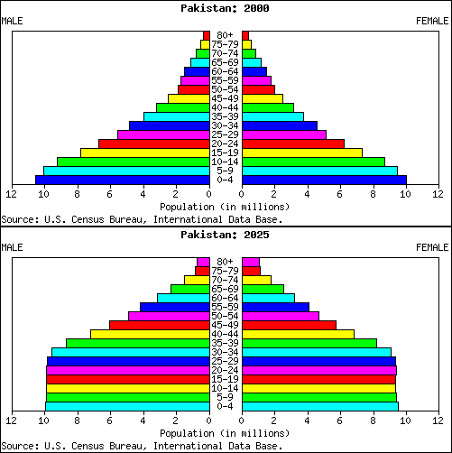
Pakistan’s Population Pyramid

Slide 49
Intensity of Poverty
 | Houshold (%) | Poor Households (%) | Intensity of Poverty Index
Rice-Wheat Punjab | 20.3 | 10.5 | 0.5
Mixed Punjab | 12.3 | 10 | 0.8
Cotton-wheat Punjab | 15.5 | 25.1 | 1.6
Barani Punjab | 6 | 0.9 | 0.2
Rice-other Sindh | 6.6 | 10.1 | 1.5
Khyber Pakhtunkhwa | 11.3 | 10 | 0.9
Low intensity Punjab | 6.7 | 12.9 | 1.9
Cotton-wheat Sindh | 17.3 | 12.6 | 0.7
Balochistan | 4.1 | 7.9 | 1.9
All Pakistan | 100 | 100 | 1

Slide 50
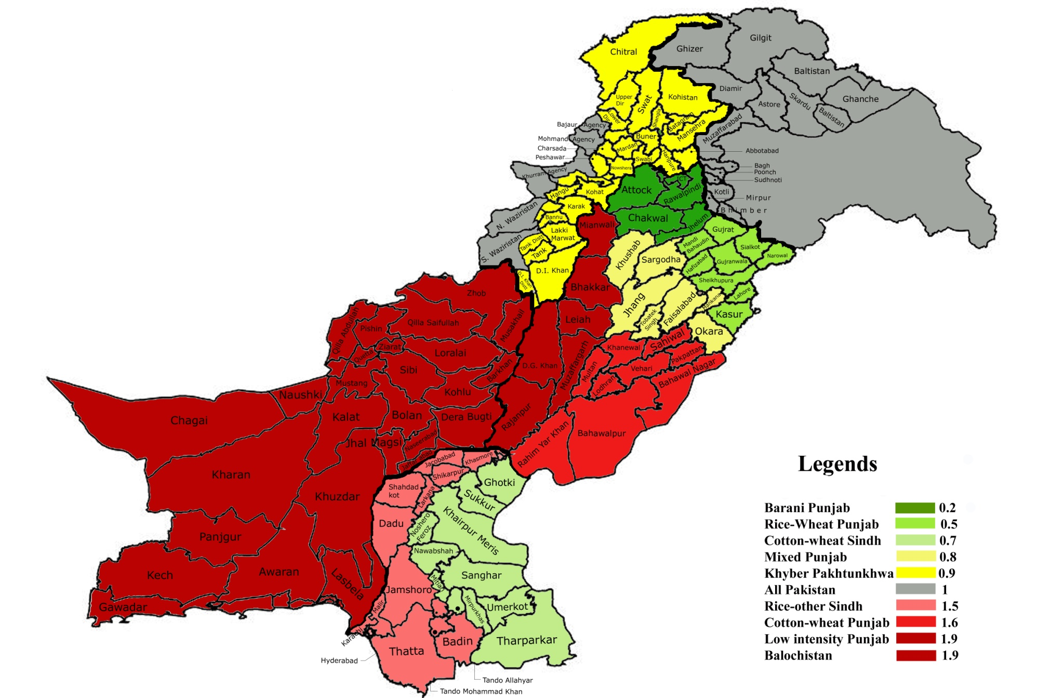
Pakistan: Agro-climatic Zones by Intensity of Poverty 2007-08
Based on FBS 2007-08 data

Slide 51
Structure of “UMEED”
Use the Network of District Level Universities/Institutions as Incubators for Groups of Young Entrepreneurs
Operate from the Infrastructure of the Universities (both hard and soft infrastructure)
Organize the groups, provide skills and get loans underwritten (guarantee loans) through PPAF
Ensure that Commercial Banks lend against PPAF guarantees and viable business Plans
Link up groups across districts to maximize on access to markets and flow of information through internet.
Groups pay for credit and use of Incubators facilities

Slide 52
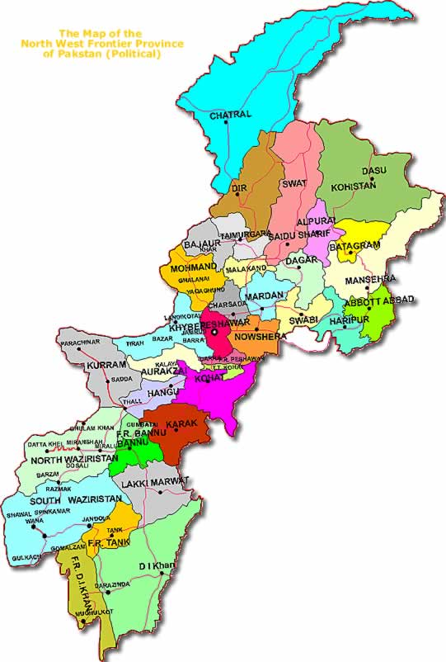
Khyber Pakhtun Khwa

Slide 53
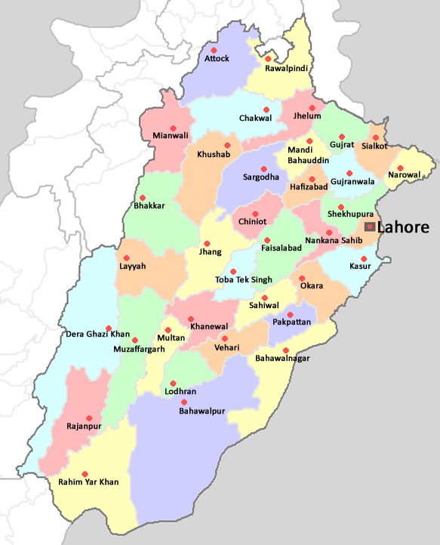
Punjab

Slide 54
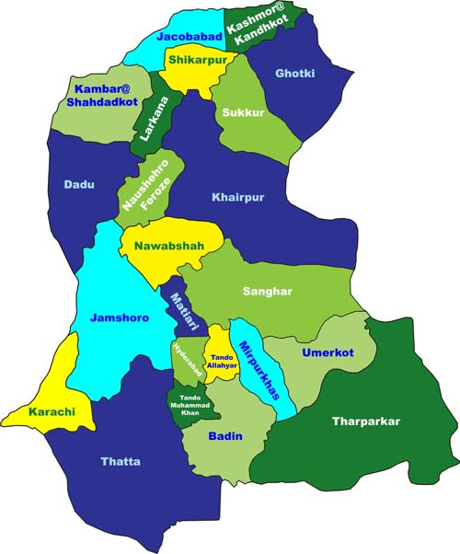
Sindh

Slide 55
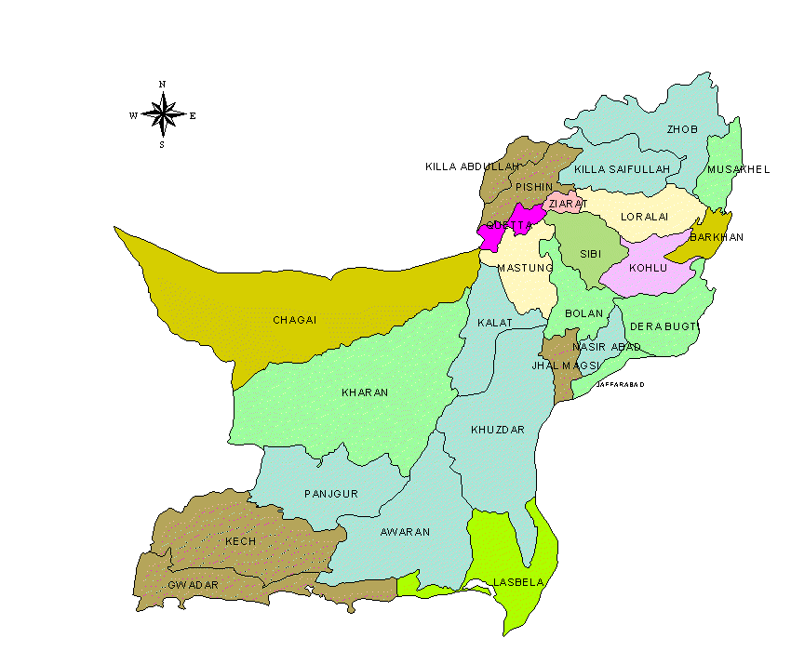
Balochistan

Slide 56
Structure of “UMEED”(contd.)
Groups to specialize in Production, Trade and Services according to comparative advantage of the Group and Niche for the District.
Groups to adhere to norms of social responsibility:
>by adopting one school, one BHU or one Mohallah
>by committing to employment of local inhabitants and use of local materials and markets
>by committing to fair business practises.
Or are expelled from participation
Each Incubator starts with 10 groups of 10 young entrepreneurs creating 10 additional jobs implies: 1000 additional employed per district – a total of 119,000 jobs in the first instance in the PPAF districts

Slide 57
The Mechanism
Groups formed on basis of advertised competition for combination of innovative employment generating business ideas based on districts needs and comparative advantage and proposal for socially responsible activity that the group will commit to undertake.
Competition to be judged by committee including central PPAF persons, Local University Business or Economics Professor and District Chamber/Association Members
HEC mandates Universities provide Incubators
Groups to be given access to University provided “Incubator” – use of office space, internet and meeting facilities

Slide 58
The University Incubators
Incubator to provide basic training in Business start up, business plan writing, templates of business contracts and information of other groups in other districts - what they are demanding and what they are supplying
Incubator run by the University jointly with PPAF/Partners linked to SMEDA and NEVTA etc acts as clearing house of information on prices of goods and services and skills and relative availabilities etc.
Incubator acts as a one stop Rural/District level Domestic Commerce Mall covering Production, Services and Trade in all areas including Agriculture as well as an Employment Bureau
Government instructs all Departments to provide priority facilitation to Young entrepreneurs

Slide 59
The Mechanism (contd.)
. State Bank to require Commercial Banks to lend to Youth Groups having feasible business plans against PPAF guarantees
Youth Groups to pay for use of Incubator at cost as well as bank interest and taxes etc as any other business
Continued participation of groups in plan conditional on
  Fair business practices
  Buying Local employing local
  Social and ethical responsibility

Slide 60
The Opportunities are ENORMOUS!

Slide 61
One Example: Potential Gains from Increases in Crop Yield
Major Crops – Rs. 607 Billion Potential Gain
CROP | GAIN from reaching achievable yields
 | Billion Rs. | %
Cotton | 143.2 | 163.6
Sugar Cane | 65.4 | 160.0
Rice | 64.8 | 94.1
Maize | 64.4 | 316.7
Wheat | 269.9 | 166.7
Source: Pakistan Agricultural Research Council Estimates

Slide 62
Example Showed Potential Gains
from increased productivity only!
Gains from better sorting, grading, packing and marketing are several times more than the gains from productivity

Slide 63
Existing Research Indentifies Enormous Potential – In Crop Sector
Input side
  New production technology
  High value crops
  timely and quality seed
  Timely and quality pesticide
  Timely and quality fertilizer
  Crop management services
Output side
  Creating bulk for market
  Creating value by sorting, grading and certification
  Packaging
  processing

Slide 64
Existing Research Indentifies Potential – In Livestock Sector
Production side
  Animal husbandry practices
  Timely and quality vaccination
  Timely and quality insemination
  Sorting, grading and certification
  High value livestock (teddy goat, aquaculture, etc)
Processing
Marketing

Slide 65
The “Umeed” Initiative Facilitates…..
Cooperation and partnerships between public and private sectors and access to key factors as financing, skills and markets.

Slide 66
The Initiative Provides:
Development of business incubators, financial mechanisms such as credit guarantees and other SME support systems.
Links Demand and Supply and backward and advanced regions
Quality Assurance and Business Confidence

Slide 67
The Initiative Ensures:
Development of Viable Commercially sustainable business models
Ongoing M&E to ensure Replic-abilty and Scale ability
Capacity Development
Builds and strengthens backward and forward linkages
Promotes Venture Capital
Social Responsibility
Self Reliance, self respect and “Umeed” for our youth

Slide 68
Join “Umeed”
Sign up by providing your name, university name, department, email and cell phone number to
network.pssp@gmail.com

Slide 69
Thank You so much

